Slide 1


Scaffolding and
Constructivism
Pedagogical Foundations for Curriculum Adaptation in SEN
Notes:
Good morning, everyone. Today, I will be presenting on 'Scaffolding and Constructivism', focusing on the pedagogical foundations for curriculum adaptation and modification, specifically for learners with Special Educational Needs, or SEN. We will explore a highly effective teaching strategy, why it works, and the theoretical framework that supports it.

Slide 2

Special Educational Needs
The Teaching Strategy: What is Scaffolding?
Scaffolding is an instructional strategy that provides temporary, tailored support to SEN learners, starting with high assistance and gradually reducing it
as their competence grows, ensuring they can successfully acquire new skills without feeling overwhelmed.
01
Definition of Scaffolding
It involves providing temporary, customized support to SEN learners when they struggle with a new
skill, starting with high-level help and gradually fading it as the student's ability and confidence
increase.
02
Primary Goal
The main objective is to help learners internalize new skills so they can eventually perform
independently, acting as a bridge to cross the gap between current ability and expected skill level.
03
Core Principle
The essence of scaffolding is dynamic support, where teachers continuously assess the learner's
progress and adjust the assistance level to ensure the student is neither frustrated nor under-
challenged.
One-on-one scaffolding in a special education setting
Notes:
To answer the first question: What teaching strategy would I use? The strategy I have chosen is 'Scaffolding'. As you can see on the slide, scaffolding involves providing temporary, customized support to SEN learners. The primary goal is to help them internalize new skills so they can eventually perform independently. The core principle here is dynamic support—constantly assessing the learner's progress and adjusting the assistance level to ensure they are neither frustrated nor under-challenged.

Slide 3
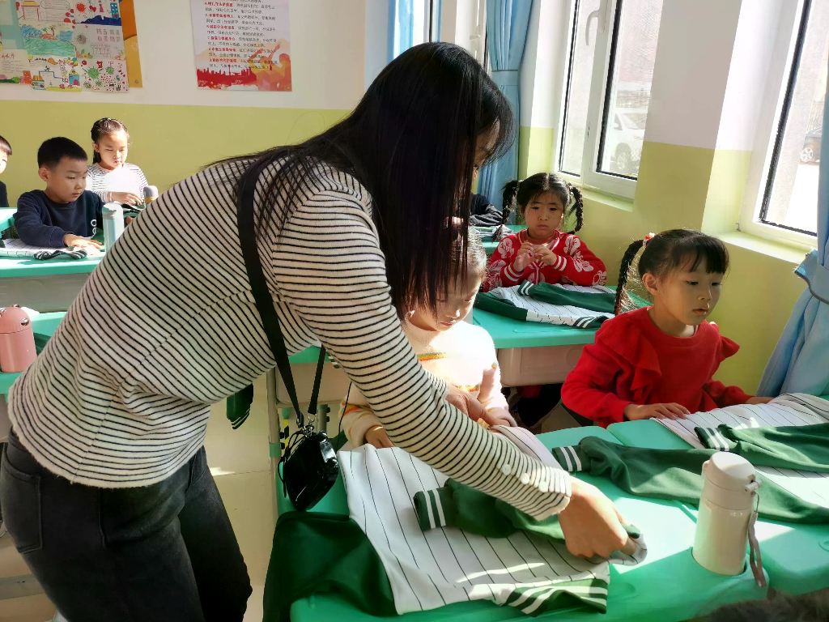
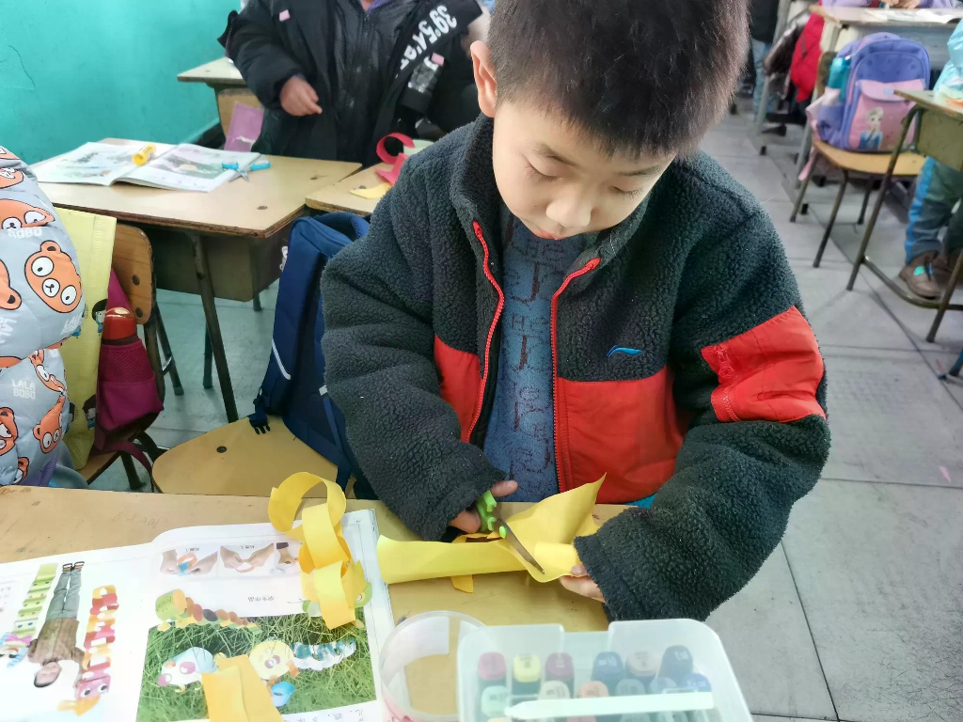
Scaffolding in Practice
Practical Application: Folding Towels
A four-step scaffolding sequence that gradually transfers responsibility from teacher to learner.
Phase 1
Phase 2
High Support Phase
Fading Support Phase
Step 1 · Modeling
The teacher demonstrates the entire
towel-folding task clearly, explaining each
step to provide a complete model of the
expected outcome.
Step 3 · Verbal Prompts
As familiarity grows, the teacher withdraws
physical help and relies only on verbal
cues such as "now fold it in half."
Step 2 · Guided Practice
Teacher modeling and physical guidance
Step 4 · Independent Practice
Student achieving independent completion
Hand-over-hand guidance helps the
student physically complete the task,
offering maximum support to ensure initial
success.
All support is removed — the student folds
independently while receiving positive
reinforcement to build confidence.
"Structured support transitions from physical guidance to complete independence, ensuring SEN learners experience success at every stage of the learning process."
Notes:
Let's look at a practical example to make this concrete: teaching a vocational skill like folding towels. In the initial stages, I use modeling and hand-over-hand guided practice to provide maximum physical support. This ensures the student experiences early success. As they become more familiar with the task, I transition to verbal prompts and eventually independent practice. This structured transition is crucial for moving the learner from dependence to autonomy.

Slide 4

Pedagogical Impact
Why It Works: Building Learner Confidence
Preventing Frustration
SEN learners often feel overwhelmed by new skills; scaffolding breaks tasks into manageable
steps, preventing the learner from feeling frustrated, anxious, or giving up entirely.
Experiencing Small Successes
By providing high initial support, scaffolding ensures learners can successfully complete tasks right
from the start, and these repeated small wins build their confidence and motivation.
Fostering a Growth Mindset
The gradual reduction of support encourages learners to take on more responsibility, nurturing the
belief that they have the capacity to learn, improve, and overcome challenges.
A learner's moment of confidence — the result of structured, step-by-step support.
"Scaffolding effectively builds confidence in SEN learners by breaking down complex tasks into manageable
steps, preventing frustration, and ensuring early successes that foster a growth mindset."
Notes:
Now, why do I think this strategy works? The first major reason is that it builds learner confidence. SEN learners often feel overwhelmed by new tasks. By breaking the task down, we prevent frustration. More importantly, the high initial support guarantees early, small successes. These repeated wins build their intrinsic motivation and foster a growth mindset, making them believe they are capable of learning and improving.

Slide 5

Why It Works
Promoting Learner Independence
The ultimate aim of scaffolding is to promote learner independence through the structured withdrawal
of support.
01
Gradual Release of Responsibility
Structured withdrawal of support is key; as learners master each step, they naturally take more
responsibility, transitioning from relying on the teacher to independent performance.
02
Developing Problem-Solving Skills
By facing manageable challenges within their learning zone, students develop their own strategies
and problem-solving abilities, which are crucial for long-term independence.
03
Internalizing Skills
The final goal is for learners to no longer need external support, having fully internalized the skill as
their own independent capability through the scaffolding process.
Learner independence through structured support withdrawal
"Enabling SEN students to develop problem-solving skills and internalize new abilities for autonomous
performance."
Notes:
The second reason this strategy is so effective is that it actively promotes learner independence, which is our ultimate educational goal. Through the gradual release of responsibility, students transition from relying on the teacher to performing independently. Facing manageable challenges within their learning zone helps them develop their own problem-solving strategies, ultimately allowing them to fully internalize the new skill.

Slide 6
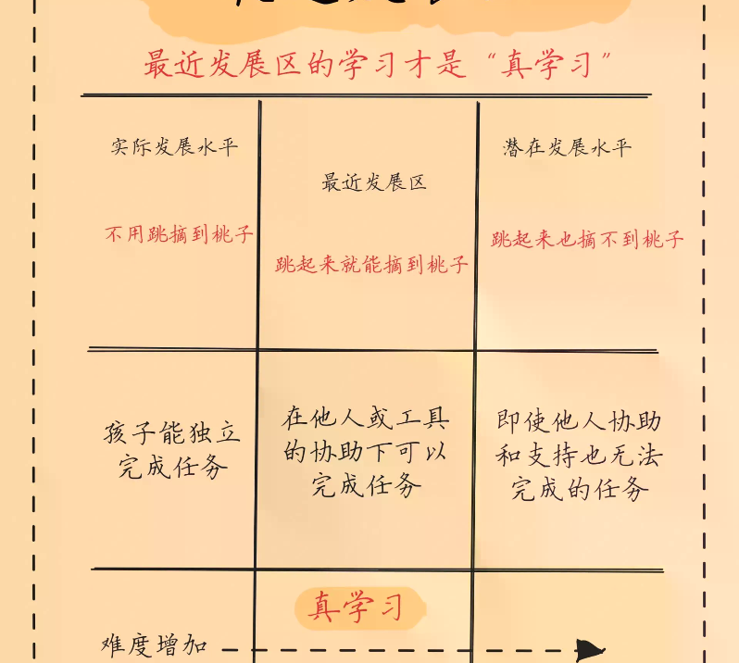
Theoretical Foundation
Theoretical Support: Vygotsky's Theory
Scaffolding is strongly supported by Lev Vygotsky's Sociocultural Theory, particularly the concept of the Zone of Proximal Development (ZPD), which emphasizes
that learning is a social process facilitated by interaction and language.
Zone of Proximal Development (ZPD)
Vygotsky defined ZPD as the gap between what a learner can do independently and what they can
achieve with guidance, highlighting the exact space where scaffolding operates.
Social Interaction is Key
The theory emphasizes that learning is inherently a social process, and interaction with a more
knowledgeable peer or teacher is crucial for cognitive development and mastering new skills.
Language as a Cognitive Tool
Language, including the teacher's instructions and the learner's internal dialogue, serves as a critical tool
for thinking and learning within the ZPD during the scaffolding process.
Zone of Proximal Development — Vygotsky's Sociocultural Framework
Notes:
This brings us to the third question: Which theory supports this strategy? Scaffolding is strongly rooted in Lev Vygotsky's Sociocultural Theory. The most critical concept here is the Zone of Proximal Development, or ZPD. Vygotsky argued that learning is a social process. The gap between what a child can do alone and what they can do with help is exactly where scaffolding takes place, using social interaction and language as cognitive tools.

Slide 7
Theory & Practice
How Theory Guides Practice
Scaffolding serves as the direct practical application of Vygotsky's Zone of Proximal Development, bridging the gap between what
learners can do alone and what they can achieve with guidance.
01
Direct Application of ZPD
Scaffolding is the practical implementation of the ZPD concept, with teacher support
specifically designed to operate within the student's zone of proximal development.
Key Insight
02
Providing Guided Assistance
"Scaffolding serves as the direct practical
application of Vygotsky's ZPD, where the teacher
acts as the 'More Knowledgeable Other' to provide
guided assistance that is systematically faded as the
learner's competence expands."
The temporary support offered in scaffolding is the guided assistance Vygotsky
identified as crucial, enabling learners to accomplish tasks beyond their independent
capabilities.
03
Fading Support & The Teacher's Role
As the learner's ability grows, support is withdrawn—reflecting the shift from the upper
limit of the ZPD to independent performance, with the teacher as the More
Knowledgeable Other.
Notes:
How does this theory directly guide our practice? Scaffolding is essentially the practical application of the ZPD. The temporary support we provide is the 'guided assistance' Vygotsky talked about. As the learner's ability grows and they master the skill, we fade the support. This reflects the shift from the upper limit of the ZPD to independent performance, with the teacher acting as the 'More Knowledgeable Other' throughout the journey.

Slide 8

Summary
Key Takeaways & Summary
Scaffolding is a highly effective, theory-backed strategy for SEN education that builds confidence through structured success and aims for
ultimate independence, perfectly aligning with Vygotsky's constructivist principles.
A Powerful Strategy for SEN
Scaffolding provides the structured support SEN learners need, working effectively by ensuring
early and repeated successes that build confidence and reduce anxiety when facing new
challenges.
Aiming for Independence
The gradual reduction of support is intentionally designed to foster learner independence, which
is the ultimate goal of any educational intervention for special needs students.
Theory Guiding Practice
Theory and practice fitting together — the scaffolding approach bridges constructivist
principles with real classroom outcomes.
This strategy is strongly backed by Vygotsky's social constructivism, specifically the ZPD
concept, proving that theoretical foundations can directly enhance practical teaching outcomes.
Notes:
To summarize the key takeaways: Scaffolding is a powerful, evidence-based strategy for SEN learners. It works by ensuring early successes that build confidence and reduce anxiety. Its ultimate aim is independence, and it is firmly grounded in Vygotsky's social constructivism. By aligning our teaching practices with these theoretical foundations, we can significantly improve learning outcomes for students with special needs.

Slide 9
Oral Presentation
Oral Presentation Guide
A structured approach to presenting pedagogical strategies — connecting practical classroom examples with theoretical frameworks.
Section 01
Section 02
Introduction & Example
Rationale & Theory
Clearly state the chosen strategy (Scaffolding) and briefly define it as
providing temporary, tailored support that is gradually reduced.
Emphasize that it prevents frustration, builds confidence through small
successes, and fosters a growth mindset for long-term independence.
Use the "folding towels" scenario to illustrate the transition from hand-
over-hand guidance to verbal prompts and final independence.
Cite Vygotsky's Sociocultural Theory and the Zone of Proximal
Development (ZPD) to validate the strategy academically.
"A successful presentation connects practical classroom examples with theoretical frameworks to demonstrate both the 'how' and the 'why' of the chosen teaching method."
Notes:
For those who will be delivering this presentation, here is a quick guide for your oral delivery. Start with a clear introduction of your chosen strategy. Use the towel-folding example to make it relatable. Explain the 'why' by focusing on confidence and independence, and anchor your argument in Vygotsky's ZPD. Keep your tone encouraging and professional, and always tie the theory back to practical classroom outcomes.

Slide 10

Scaffolding and Constructivism
Thank You
Questions & Discussion
Notes:
Thank you all for your time and attention today. I hope this presentation has provided a clear understanding of how scaffolding and constructivist theory can be effectively applied to support learners with special educational needs. I am now happy to take any questions or hear your thoughts on this topic.

