Slide 1


Inclusive Education & Rehabilitation
A Multidimensional Analysis of Support Systems for Children with Special Needs in Brunei Darussalam and Singapore

Slide 2

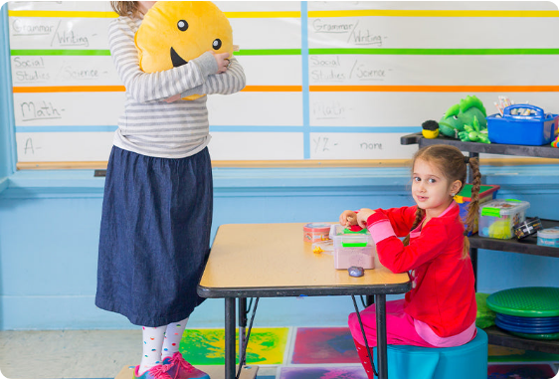
Background & Research Context
Global Imperative: The UN Convention on the Rights of Persons with Disabilities (CRPD) mandates a continuous, seamless continuum of educational, rehabilitative, and social support services.
Regional Focus: Both Brunei Darussalam and Singapore are high-income Southeast Asian nations with contrasting governance structures, cultural settings, and administrative mechanisms.
Core Objective: Evaluate national policies against grassroots practice across eleven systematic dimensions to draw evidence-based insights for ASEAN inclusion models.

Slide 3







Research Scope & Methodology
Documentary Analysis
Empirical Insights
11 Dimensions
Systematic review of official national policy texts, Parliamentary replies, WHO guidelines, and SEAMEO reports.
Synthesis of local empirical studies from Universiti Brunei Darussalam, PMC journals, and NGO survey reports.
Comprehensive evaluation spanning policy, screening, assessment, intervention, transition, CBR, AT, and family support.

Slide 4




Top-Level Policy Frameworks
Brunei Darussalam
Singapore
•
SPN21 Reform: Endorses inclusive education under 21st-century national education reform.
•
Enable Masterplan: Quinquennial top-level roadmap coordinating lifelong disability services.
•
Cultural Ethos: Melayu Islam Beraja (MIB) philosophy guides support for vulnerable groups.
•
Compulsory Education: Children with special needs included under compulsory education since 2019.
•
Administrative Fragmentation: Dual-track system split between MOE (general) and MoRA (religious schools).
•
Multi-Agency Model: Integrated responsibilities across MOE (schools), MSF (early intervention), and SG Enable.
•
Policy Gap: Lack of antidiscrimination laws and mandatory Individualised Education Plans (IEPs).
•
Institutionalized IEPs: Mandatory and systematically reviewed across mainstream and SPED schools.

Slide 5


Early-Stage Screening Systems
Brunei: Hospital-Centric Model
Singapore: Decentralised Ecosystem
Primary Screening Node: Centralised at RIPAS Hospital's Child Development Centre (CDC) in the capital.
Universal Screening: Nationwide health handbooks with age-stratified developmental scales (0-6 years).
Key Limitations: Community health centers lack standardized screening tools; primary detection relies heavily on parental vigilance.
Preschool Integration: ECDA InSP programme embeds early screening directly within regular kindergartens.
Secondary Identification: Universal language & literacy screening at Primary 1 entry by SEN Officers.
Service Delays: Rural/suburban families face long travel distances, lengthy waiting lists, and zero interim support.

Slide 6

Diagnostic Assessment Systems
Assessment Dimension | Brunei Darussalam | Singapore
Medical Diagnosis | Centralised CDC hospital multidisciplinary team | Hospital pediatric teams & specialist clinics
Educational Toolkit | Priority Levels tool (MOE general schools only) | Standardised psychological & functional scales
Interagency Data Transfer | Manual report submission by parents | Formal automated interagency file transfers
Interim Support | Unavailable during waitlist periods | Immediate in-school support during 2-month assessment

Slide 7
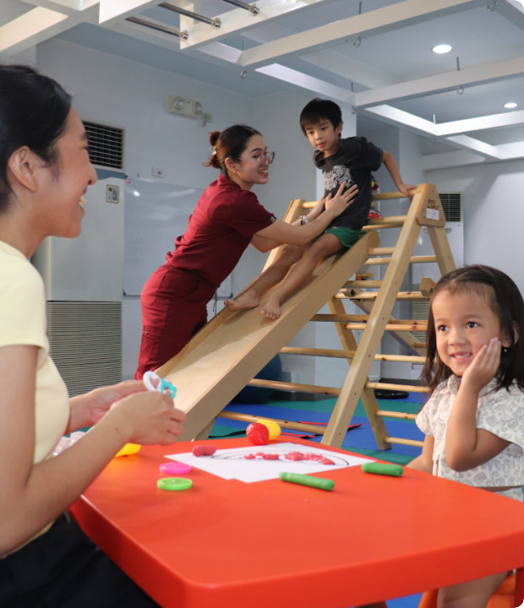
Early Intervention Delivery
Intervention Pathways
Brunei Darussalam: Hospital-based therapies supplemented by fee-based NGO providers (e.g., Learning Ladders ABA therapy). In-school SENA assistant support is constrained by staffing quotas, with no coverage in religious classrooms.
Singapore: Comprehensive EIPIC early intervention centers and InSP embedded preschool programmes. Mainstream primary schools feature targeted TRANSIT programmes for socio-behavioral needs.

Slide 8




Educational Transition Pathways
School -> Work
Preschool -> Primary
SG School-to-Work (S2W) & SG Enable; informal family path in Brunei.
Formal file transfer in SG; manual parent submission in Brunei.
0-6 Years
Primary -> Secondary
Screening at birth. EIPIC / CDC intervention onset.
SEN tracking in SG; dual-stream fragmentation in Brunei.

Slide 9


Community-Based Rehabilitation
Brunei: Nascent Community Setup
Singapore: Integrated SSA Network
No National CBR Policy: Absence of an official, standardized community-based rehabilitation framework.
Social Service Agencies: AWWA, Rainbow Centre, and others act as community nodes for daycare and respite care.
Civil Society Role: Parent-led NGOs fill service vacuums; high potential for mosque-based social infrastructure.
Community Hubs: Disability support embedded directly into neighborhood family service networks.
Resource Gaps: Severe lack of community therapists in suburban and rural districts.
Lifelong Support: Smooth continuum extending from early childhood into adult community care.

Slide 10

Family Support & Stress Relief
Psychosocial Empowerment
>60%
Financial Subsidies: Brunei provides monthly disability allowances (<15 yrs); Singapore offers EIPIC/SPED subsidies and tax relief.
Respite & Peer Support: Singapore systematically pilots Parent Peer Support and institutionalised respite care; Brunei relies on informal religious coping with zero formal respite services.
Caregiver High-Stress Rate in Brunei

Slide 11


Healthcare & Assistive Tech
Healthcare Provision
Assistive Technology (AT)
Brunei: Universal low-cost public healthcare. Specialized rehab therapy centered at capital hospital with long waiting lists.
Brunei: Hospital-procured devices; lack of unified subsidies and limited AT teacher training in schools.
Singapore: Coexisting public/private system backed by Medisave, Medifund, and funded surgeries (e.g., cochlear implants).
Singapore: State-funded AT devices (hearing aids, screen magnifiers) and AI digital learning initiatives in SPED schools.

Slide 12
Pedagogies & Workforce Development
Specialized Workforce Expansion: Singapore NIE expands SPED training quotas to 180 seats/yr; Brunei relies on introductory modules via the Brunei Darussalam Teachers’ Academy (BDTA).
In-School Professional Roles: Singapore stations SEN Officers & Allied Educators in mainstream schools; Brunei SENA special educator quotas remain constrained.
Universal Design for Learning (UDL): Systematically implemented in Singapore mainstream classrooms; non-mandatory in Brunei leading to school-level implementation variance.
School Twinning Initiatives: Singapore pairs mainstream and SPED schools to foster social inclusion and peer interaction.

Slide 13
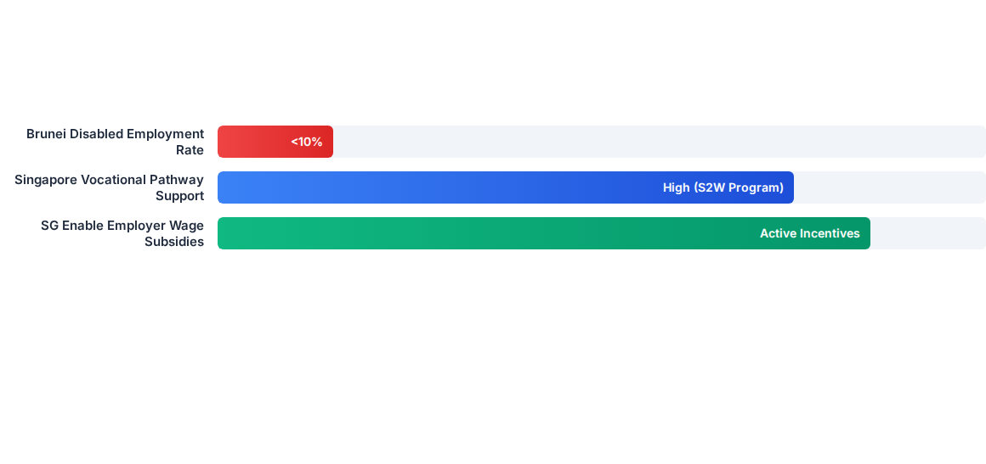
Employment & Adult Transition
Transition Bottleneck: High national GNI does not automatically yield high employment rates. While Singapore utilizes job coaches and SG Enable wage subsidies, Brunei faces structural gaps with under 10% workforce participation among adults with special needs.

Slide 14

Comparative Dimensions Matrix
Dimension | Brunei Darussalam | Singapore
Governance & Policy | SPN21 / MIB Ethos (Fragmented MoE-MoRA) | Enable Masterplan / Compulsory Education Act
Interagency Sync | Manual paper file transfers by families | Closed-loop digital & interagency integration
Early Intervention | Hospital-centric at CDC; limited rural outreach | ECDA InSP (Preschool) & EIPIC Centers
CBR Infrastructure | Informal / NGO-driven / Mosque potential | Institutionalised SSA community network
Adult Employment | Family-dependent; lack of reasonable accommodation | SG Enable, S2W scheme, job coach matching

Slide 15
Shared Challenges & Insights
Common Bottlenecks: Both nations face teacher capacity constraints in assistive technology deployment, behavioral intervention, and lingering workplace discrimination.
Dual-Track Administrative Alignment: Brunei must establish interministerial coordination between MoE and MoRA to harmonize special education across religious and general schools.
CBR as a Buffer Layer: Developing local community-based rehabilitation buffering layers can mitigate long hospital assessment waiting lists.
Holistic Family Wellbeing: Transition support must incorporate caregiver mental health and parent peer support, transcending child-only skills training.

Slide 16


Thank You
A Seamless Inclusive Education Continuum Requires Interagency Synergy, Community CBR Buffers & Holistic Family Empowerment.

Slide 17


Image Sources
http://funandfunction.com/cdn/shop/articles/24341f4c788d2d65c37e8bc858950367.jpg?v=1761784609
Source: funandfunction.com
https://cmc.ph/wp-content/uploads/2025/08/IMG_2402-scaled.jpg
Source: cmc.ph

