Slide 1


Special Education in China
Development, Modern Practice, and Inclusive Horizons

Slide 2


Slide 3

Scale & Key Milestones
95%+
National Educational Commitment
Compulsory Education Enrollment Rate
900,000+
China has made special education a national priority under the 9-Year Compulsory Education Law.
Through strategic 5-year improvement plans, the nationwide framework guarantees that children with physical, sensory, or developmental needs receive fully funded, accessible basic education.
Special Needs Students Currently Enrolled
2,200+
Dedicated Special Education Institutions

Slide 4






Three-Tier Placement System
1. Regular Classrooms (LRC)
2. Special Education Schools
3. Home-Based Delivery
Over 50-60% of students with mild-to-moderate disabilities attend regular schools via "Learning in Regular Classrooms" (随班就读), supported by resource rooms and itinerant teachers.
Dedicated state-of-the-art schools tailored for students with visual, hearing, intellectual impairments, or autism spectrum disorder (ASD) requiring intensive rehabilitation.
"Song Jiao Shang Men" (送教上门) sends mobile special educators directly into households for children with severe disabilities unable to physically attend school.

Slide 5

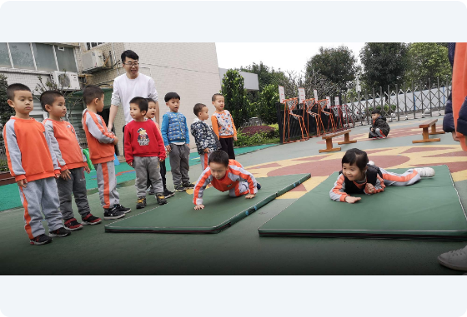
Medical & Educational Synergy
Integrated "Medical-Education" Model
Chinese special education deeply merges medical rehabilitation with pedagogical goals (医康教结合):
On-site Therapy Rooms: Physical (PT), Occupational (OT), and Speech Therapy (ST) integrated into daily schedules.
Sensory Integration: Dedicated rooms helping children with ASD and cognitive delays improve motor skills.
Personalized IEPs: Joint teams of doctors, special educators, and therapists craft Individualized Education Plans.

Slide 6
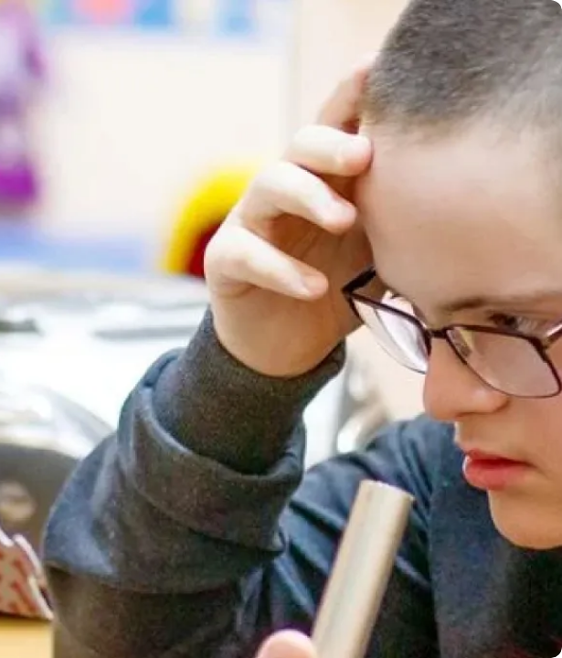
Technology & Empowerment
Assistive Innovation in Classrooms
AI Speech-to-Text: Real-time visual subtitles for deaf and hard-of-hearing students during standard lectures.
VR Social Simulation: Virtual reality modules allowing students with autism to practice riding public transport or shopping safely.
Eye-Tracking Hardware: Assistive input devices enabling severely motor-impaired youth to write and communicate digitally.

Slide 7




Lifelong Learning Pathways
Compulsory Years
Higher Education
Grades 1-9: Free basic education with tailored special curriculum standards.
Special colleges (e.g., Changchun Univ.) offering bachelor's & master's degrees.
Early Intervention
Vocational High
Ages 0-6: Free rehabilitation screening and inclusive nursery programs.
Grades 10-12: Training in baking, horticulture, car detailing, & e-commerce.

Slide 8
Differentiated Support Systems
Category | Primary Placement | Core Focus Area | Key Support Tools
Hearing Impairment | Special / Mainstream | Speech language & Auditory training | AI live captioning, FM hearing tech
Visual Impairment | Specialized Schools | Orientation, Mobility & Tactile skills | Refreshable Braille displays, Audiobooks
Intellectual Disability | LRC / Special Schools | Life skills & Self-care autonomy | Pictorial task boards, Sensory rooms
Autism Spectrum (ASD) | Inclusive Classrooms | Social communication & Adaptability | Shadow teachers, VR scenarios

Slide 9


Inclusive Early Childhood
Early Integration Builds Empathy （共情）
Supported by domestic initiatives and international partnerships (such as UNICEF), China is expanding pilot Inclusive Kindergartens.
Children with and without developmental delays play, create, and learn together from age 3.
This early interaction dramatically improves social adaptability for special needs children while nurturing empathy, kindness, and peer acceptance among mainstream students.

Slide 10
Core Philosophy
Give every child a pair of wings, and they will soar into a dignified, self-reliant future.
"
给每个孩子一双翅膀，他们就能翱翔于一个尊严而自立的未来之中。
— Chinese Special Educator's Motto
"

Slide 11
Terima Kasih!
Thank you to our Malaysian teachers & students!
Let us build an inclusive, supportive world for all children together.

