Slide 1

Rehabilitation-Education Transition in Inclusive Education
A Comparative Analysis of Mechanisms across China, Malaysia, Brunei, and Singapore

Slide 2

Executive Summary
Research Objective
Key Findings
Examines how health/rehabilitation services bridge into mainstream schooling for children with special educational needs (SEN). Evaluates structural continuity across four distinct Asian healthcare and education jurisdictions.
While policy commitments to inclusive education have grown, significant barriers remain in inter-agency data sharing, professional training alignment, and lifelong transition planning from childhood to adulthood.

Slide 3
Dual-Axis Transition Continuum
Horizontal Continuity
Vertical Continuity
Focuses on cross-sectoral collaboration between clinical healthcare, rehabilitation centers, early intervention hubs, and mainstream resource classrooms. Ensures seamless service referrals and shared diagnostic records.
Ensures smooth lifelong transitions across developmental milestones: Preschool → Elementary → Secondary Education → Vocational Training → Independent Adult Living and Social Inclusion.

Slide 4





Key Stages of Transition
1. Screening & Assessment
2. Referral & Placement
3. IEP & Progress Tracking
Early clinical diagnosis, developmental monitoring, and multi-disciplinary functional evaluation.
Formal placement decisions (mainstream, resource room, or special school) and inter-agency referral.
Student case handover, Individualized Education Plan (IEP) formulation, and longitudinal tracking.

Slide 5

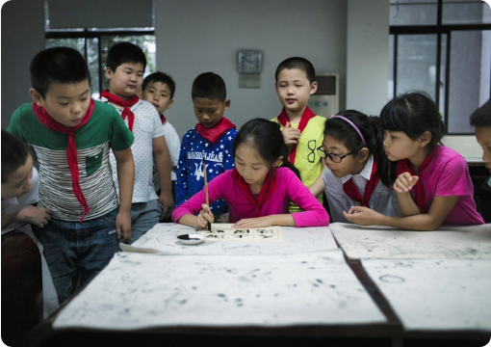
China: Statutory Panels & Screening
County-Level Expert Committees: Multi-agency panels (Education, Health, Disabled Persons' Federation) lead statutory assessment and school placement rulings.
0–6 Health Screening Network: Standardized early identification chain featuring 11 routine pediatric exams, specialized secondary screening, and clinical confirmation.
Multi-Tiered Placement Options: Emphasizes LRC (Learning in Regular Classrooms), resource rooms, special education schools, and home-based visiting education.

Slide 6
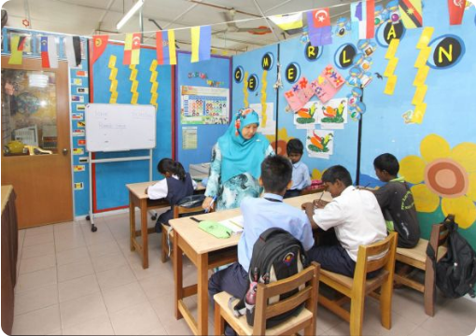
Malaysia: Zero-Rejection Policy
Zero-Rejection Policy (Dasar Sıfar Penolakan): Guarantees schooling access for children with SEN, eliminating historical educability screening exams.
School-Level Discretion: School administrators hold localized autonomy regarding class readiness, resource allocation, and practical placement.
Community Rehabilitation (PDK): Community-Based Rehabilitation centers act as pivotal hubs for early intervention, family support, and pre-school transition.

Slide 7
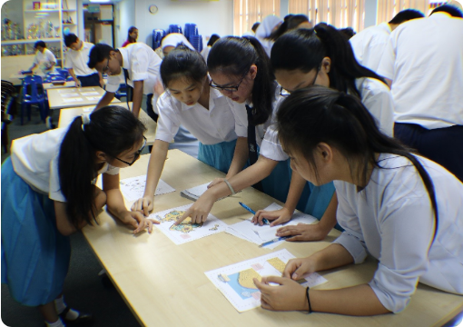
Brunei: Inclusive Framework
Inclusive Education Policy (2022): Codifies rights for special needs children in mainstream schools under the Department of Special Education.
SENA Teacher Model: Special Education Needs Assistant (SENA) teachers coordinate school-based teams to execute Individualized Education Plans (IEPs).
Standardization Work: Ongoing efforts to establish unified referral documentation between secular mainstream and religious (Ugama) schools.

Slide 8

Singapore: EIPIC & SPED Pathways
Age-Prioritized Intervention (EIPIC): Early Intervention Programme for Infants & Children prioritizes ages 5–6 to secure 1+ years of clinical therapy prior to school age.
Centralized MOE Screening: Special Education (SPED) school applications undergo unified Ministry review to optimize resource allocation.
Individual Transition Plans (ITP): Mandatory across all 20+ SPED schools, systematically mapping out vocational training and independent living pathways.

Slide 9
Policy Comparison Matrix
Dimension | China | Malaysia | Brunei | Singapore
Governance | County expert committee multi-agency rulings | National policy directives + School autonomy | Special Education Department + SENA teams | Centralized MOE panel & sector alignment
Placement | Statutory evaluation & appeal mechanisms | School-level placement under Zero-Rejection | Needs-based school evaluation & IEP design | Clinical assessment & central MOE screening
Data Transfer | Robust health tracking; cross-agency silos | Mainly manual parent-driven paper portfolios | Developing inter-agency transfer protocols | Formalized inter-agency digital data exchange
Key Challenges | Regional urban-rural resource disparities | Variable school-level policy implementation | Need for standardized transfer forms | Subsidy eligibility tied to citizenship status

Slide 10
Shared Systemic Bottlenecks
Heavy Family Burden
Delayed Longitudinal Planning
Specialist Workforce Gaps
Parents often bear the burden of acting as manual case coordinators, transferring paper medical records to school authorities.
Transition planning is heavily front-loaded at preschool entry, leaving secondary-to-adult vocational transition under-supported.
Acute regional shortages of Speech Language Therapists (SLTs), Occupational Therapists (OTs), and certified SEN educators.

Slide 11

Key Governance Tensions
Central Standardization vs. Local Autonomy
Administrative Speed vs. Family-Centered Choice
Centralized national criteria safeguard educational equity but can exceed local school capacity. Flexible school autonomy improves adaptability but leads to inconsistent placement standards across regions.
Streamlined administrative review speeds up placement processing, but can marginalize parental input. Effective frameworks must balance administrative efficiency with meaningful family advocacy.

Slide 12
Cross-Sector Data Integration
Unified Digital Case File Systems: Developing secure digital bridges connecting clinical pediatric health records directly with school Special Needs Coordinators.
Privacy & Consent Protocols: Standardizing parental consent models to allow seamless diagnostic data sharing between hospitals and schools.
Longitudinal Outcome Tracking: Tracking child developmental milestones continuously from early diagnosis into adult employment outcomes.

Slide 13
Life-Course & Vocational Support
Early Secondary Transition Planning: Initiating formal vocational readiness and independent living goals by age 12 to 14 within the IEP.
Public-Private Industry Pathways: Partnering with vocational institutes and inclusive employers to provide structured internships for SEN graduates.
Community Independent Living: Expanding community-based group homes and sheltered workshops to ensure post-school social inclusion.

Slide 14
Strategic Policy Roadmap
1. Single-Page Transfer Formats
2. Interim Support During Waitlists
3. Backwards-Designed IEPs
Adopt standardized 1-page summary handover checklists between medical clinics and school SEN teams.
Mobilize community centers to provide structured interim therapies while children await school placement.
Design early childhood goals with long-term adult independence and vocational readiness in mind.

Slide 15
Regional ASEAN Cooperation
Shared Assessment Standards
Joint Professional Accreditation
Leverage ASEAN regional networks to co-develop standardized developmental screening tools, culturally adapted assessment frameworks, and shared metric benchmarks across member states.
Establish cross-border training modules and certification standards for Special Education Needs (SEN) teachers, allied health professionals, and pediatric rehabilitation specialists.

Slide 16

Thank You
Building a Seamless, Lifelong Support Ecosystem for Children with Special Needs

Slide 17




Image Sources
https://opensocietyfoundations.imgix.net/uploads/69f4d6eb-d08c-442c-8adc-9378ceccaaa8/20170426-dufour-china-classroom-3000.jpg?auto=compress%2Cformat&fit=min&fm=jpg&q=80&rect=%2C%2C%2C&w=760
Source: www.opensocietyfoundations.org
https://dapmalaysia.org/en/wordpress/wp-content/uploads/2022/08/special-needs-kids.jpg
Source: dapmalaysia.org
https://globalyoungacademy.net/wp-content/uploads/2018/02/Brunei-2018.jpg
Source: globalyoungacademy.net
https://www.sassymamasg.com/wp-content/uploads/2024/04/230401-3184.jpg
Source: www.sassymamasg.com

